Slide 1
Genetic Algorithms Continued

Slide 2
Crossover Techniques in Real-Coded GAs
Real-Coded GAs help in carrying out optimization in continuous search space
Crossover Schemes
Linear Crossover
Blend Crossover
Binary Simulated Crossover

Slide 3
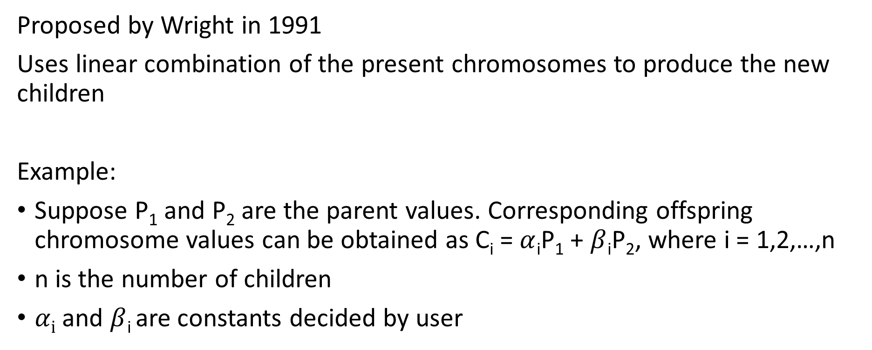
Linear Crossover in Real-Coded GAs
Proposed by Wright in 1991
Uses linear combination of the present chromosomes to produce the new children
Example:
Suppose P₁ and P₂ are the parent values. Corresponding offspring chromosome values can be obtained as C_{i} = $α$_{i}P₁ + $β$_{i}P₂, where i = 1,2,…,n
n is the number of children
$αi$ and $β$_{i} are constants decided by user

Slide 4
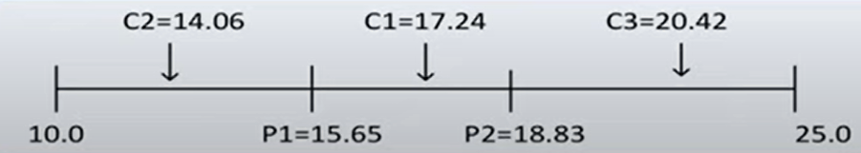
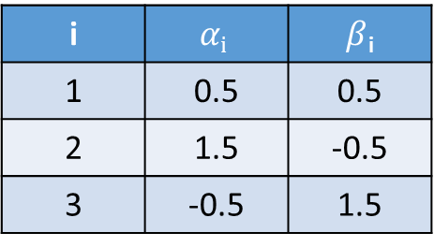
Linear Crossover: Example
Suppose P₁ = 15.65 and P₂ = 18.83
i | $$αi$$ | $β$_{i}
1 | 0.5 | 0.5
2 | 1.5 | -0.5
3 | -0.5 | 1.5
Offspring Chromosome
C₁ = 0.5*15.65 + 0.5*18.83 = 17.24
C₂ = 1.5*15.65 - 0.5*18.83 = 14.06
C₃ =-0.5*15.65 + 1.5*18.83 = 20.24

Slide 5
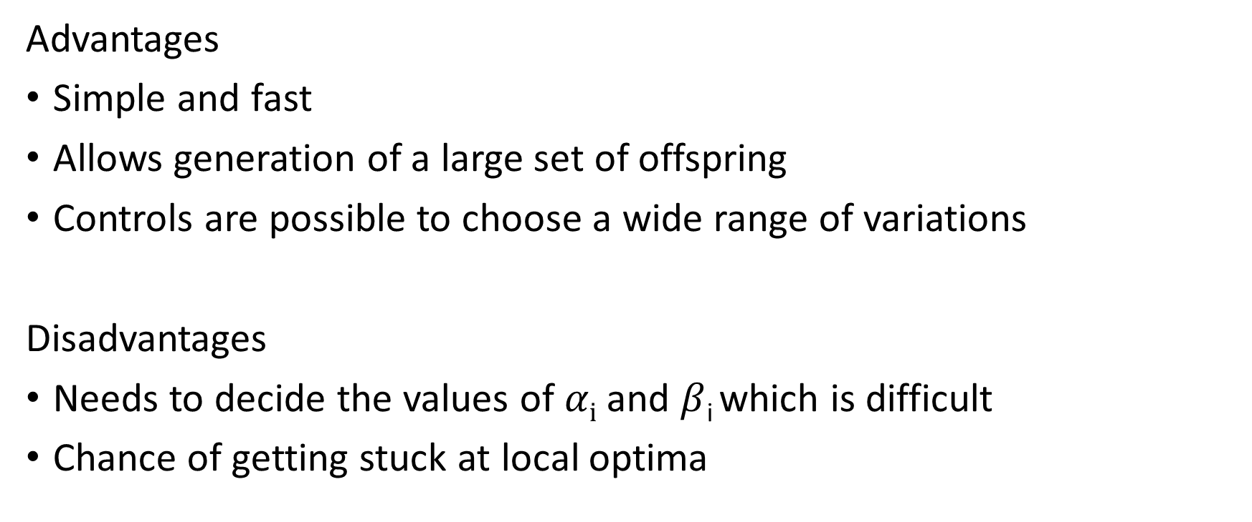
Advantages and Limitations
Advantages
Simple and fast
Allows generation of a large set of offspring
Controls are possible to choose a wide range of variations
Disadvantages
Needs to decide the values of $αi$ and $β$_{i} which is difficult
Chance of getting stuck at local optima

Slide 6
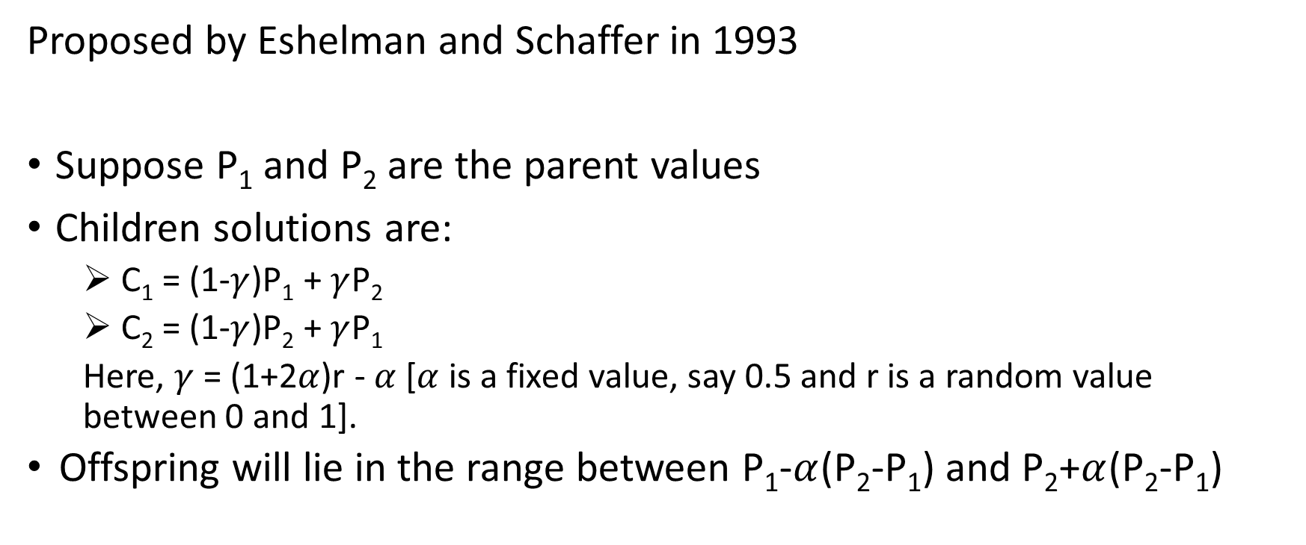
Blend Crossover in Real-Coded GAs
Proposed by Eshelman and Schaffer in 1993
Suppose P₁ and P₂ are the parent values
Children solutions are:
C₁ = (1-$γ$)P₁ + $γ$P₂
C₂ = (1-$γ$)P₂ + $γ$P₁
Here, $γ$ = (1+2$α$)r - $α$ [$α$ is a fixed value, say 0.5 and r is a random value between 0 and 1].
Offspring will lie in the range between P₁-$α$(P₂-P₁) and P₂+$α$(P₂-P₁)

Slide 7
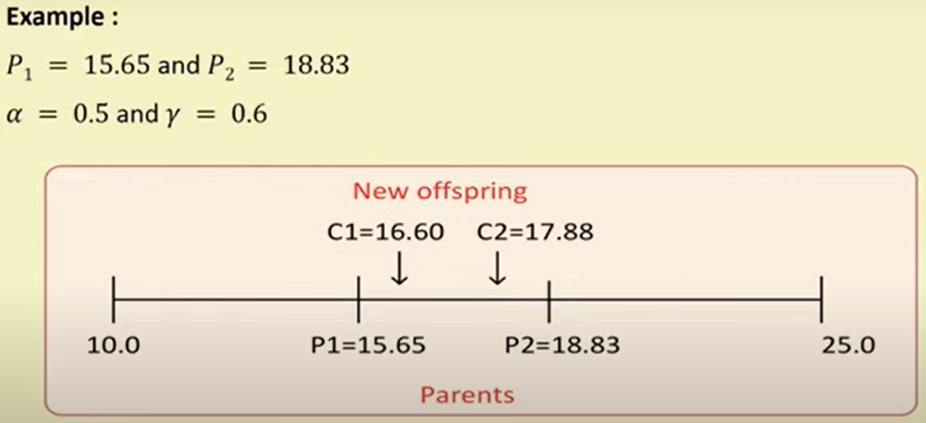
Blend Crossover in Real-Coded GAs: Example

Slide 8
Blend Crossover in Real-Coded GAs
Advantages
Simple and fast
Allows generating a large set of offspring from two parent values
Controls are possible to choose a wide range of variations
Disadvantages
Decision about the parameter values is critical. If not properly chosen, it can get stuck in local optima

Slide 9
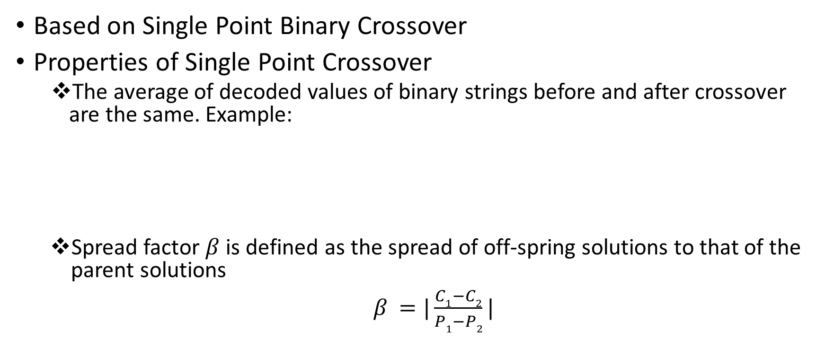
Simulated Binary Crossover in Real-Coded GAs
Based on Single Point Binary Crossover
Properties of Single Point Crossover
The average of decoded values of binary strings before and after crossover are the same. Example:
Spread factor $β$ is defined as the spread of off-spring solutions to that of the parent solutions
$β$ $=|\frac{C1−C2}{P1−P2}|$
Parents | Offsprings
10|1001 (=41₁₀) | 10|1010 (=42₁₀)
01|1010 (=26₁₀) | 01|1001 (=25₁₀)
Avg = 33.5 | Avg = 33.5

Slide 10
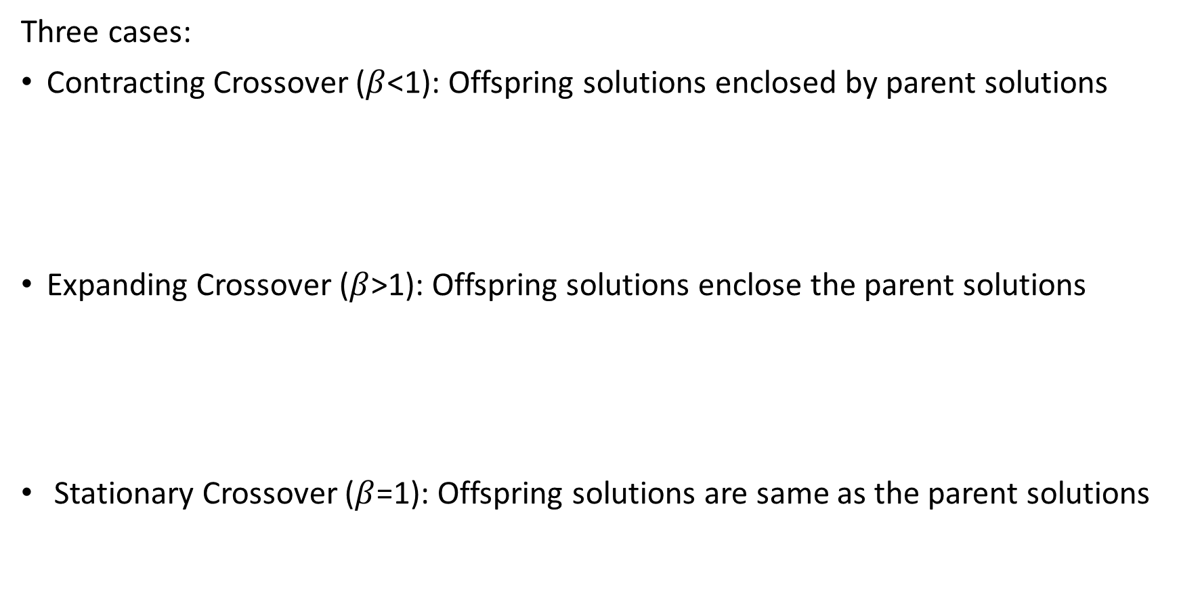
Simulated Binary Crossover in Real-Coded GAs
Three cases:
Contracting Crossover ($β$<1): Offspring solutions enclosed by parent solutions
Expanding Crossover ($β$>1): Offspring solutions enclose the parent solutions
Stationary Crossover ($β$=1): Offspring solutions are same as the parent solutions
C₁
C₂
P₁
P₂
C₁
C₂
P₁
P₂
C₁
C₂
P₁
P₂

Slide 11
Simulated Binary Crossover in Real-Coded GAs
This scheme is proposed in the following paper:
K. Deb and RB Agarwal: Simulated Binary Crossover for Continuous Search Space, Complex Systems, 9(2): 115-148, 1995.
Abbreviated as SBX and designed with respect to one-point crossover properties in binary-coded GA, i.e., Average Property and Spread-factor Property

Slide 12
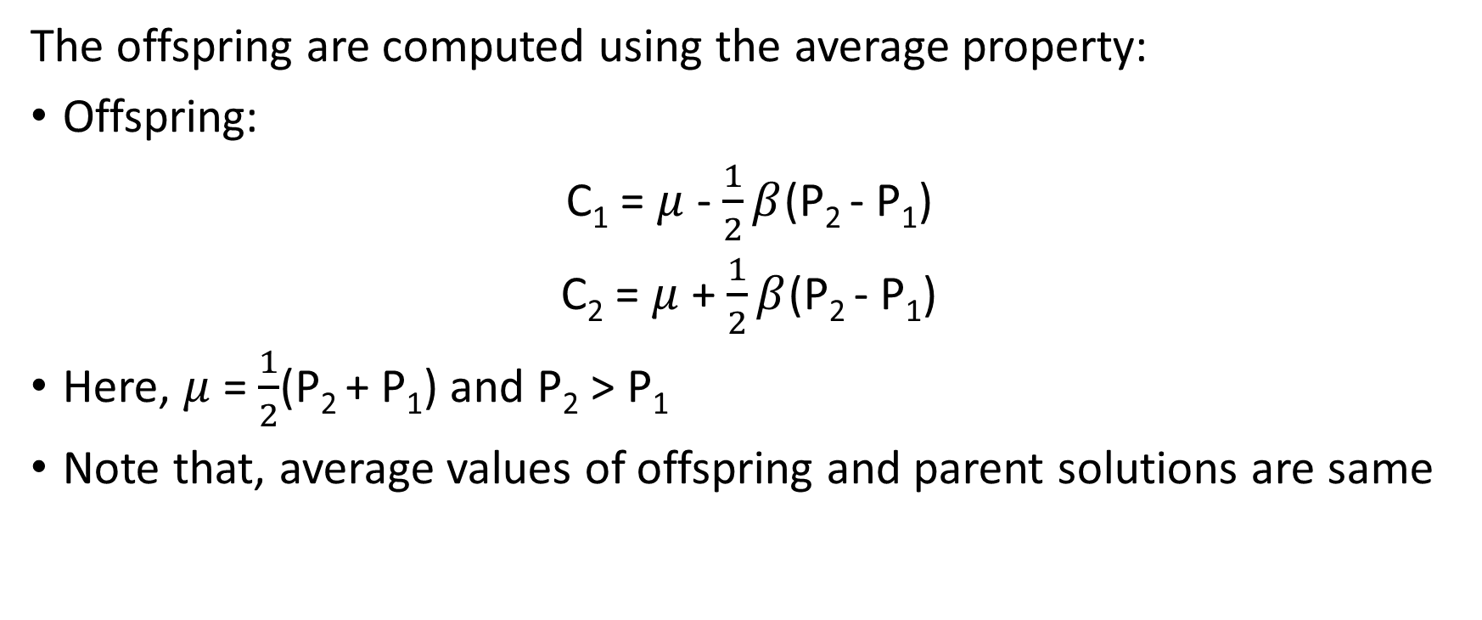
Simulated Binary Crossover in Real-Coded GAs
The offspring are computed using the average property:
Offspring:
C₁ = $μ$ - $\frac{1}{2}β$(P₂ - P₁)
C₂ = $μ$ + $\frac{1}{2}β$(P₂ - P₁)
Here, $μ$ = $\frac{1}{2}$(P₂ + P₁) and P₂ > P₁
Note that, average values of offspring and parent solutions are same

Slide 13
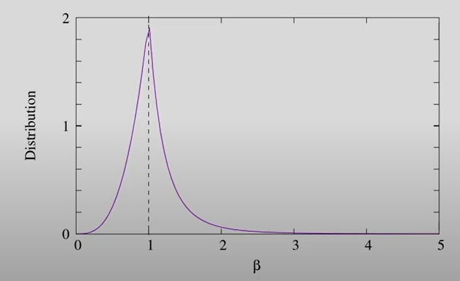
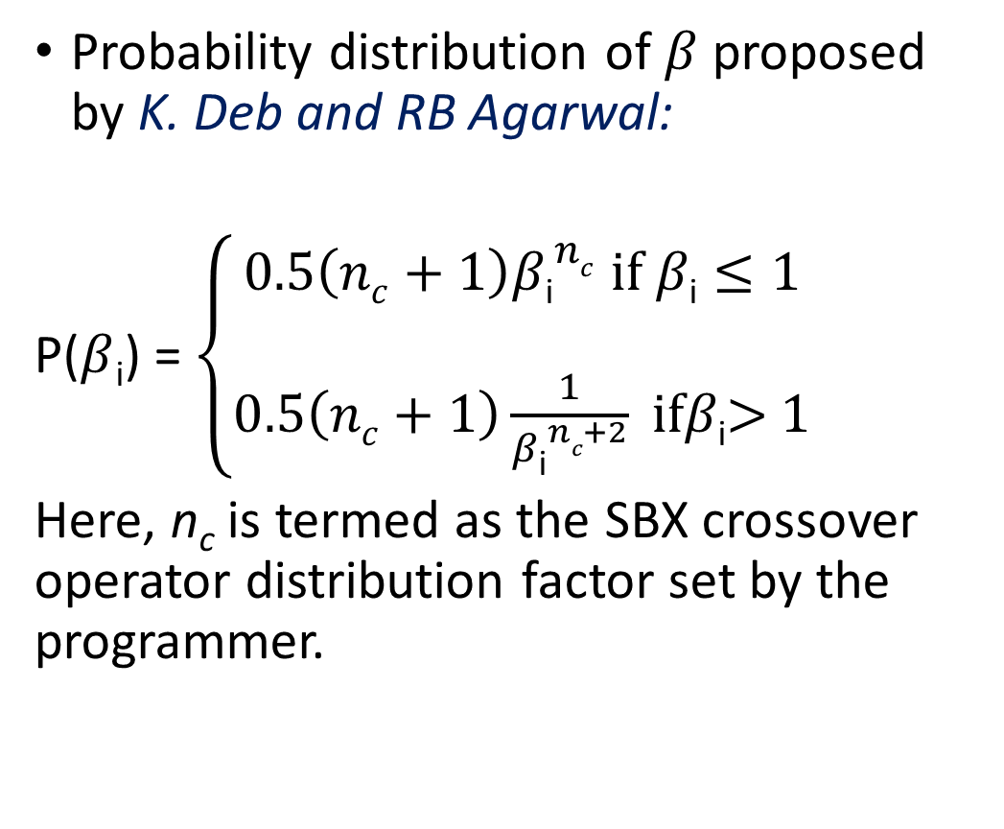
Simulated Binary Crossover in Real-Coded GAs
Probability distribution of $β$ proposed by K. Deb and RB Agarwal:
P($β$_{i}) = $\left\{\begin{aligned}0.5\left(nc+1\right){β\text{i}}^{nc} if β\text{i}≤1 \\ \\ 0.5\left(nc+1\right)\frac{1}{{β\text{i}}^{nc+2}} ifβ\text{i}\text{> }1\end{aligned}\right.$
Here, n_{c} is termed as the SBX crossover operator distribution factor set by the programmer.

Slide 14
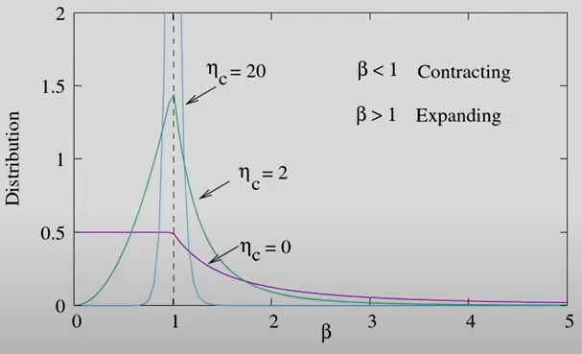
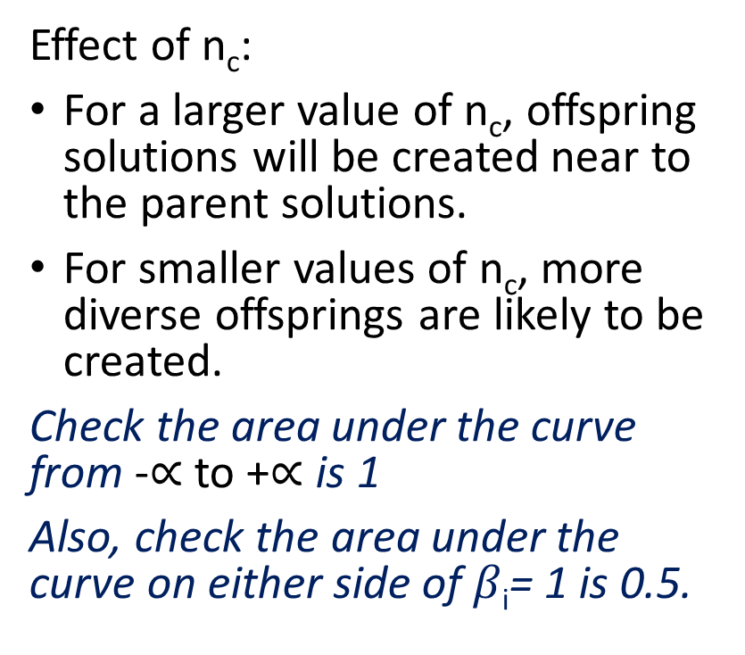
Simulated Binary Crossover in Real-Coded GAs
Effect of n_{c}:
For a larger value of n_{c}, offspring solutions will be created near to the parent solutions.
For smaller values of n_{c}, more diverse offsprings are likely to be created.
Check the area under the curve from -$∝$ to +$∝$ is 1
Also, check the area under the curve on either side of $β\text{i}$= 1 is 0.5.

Slide 15
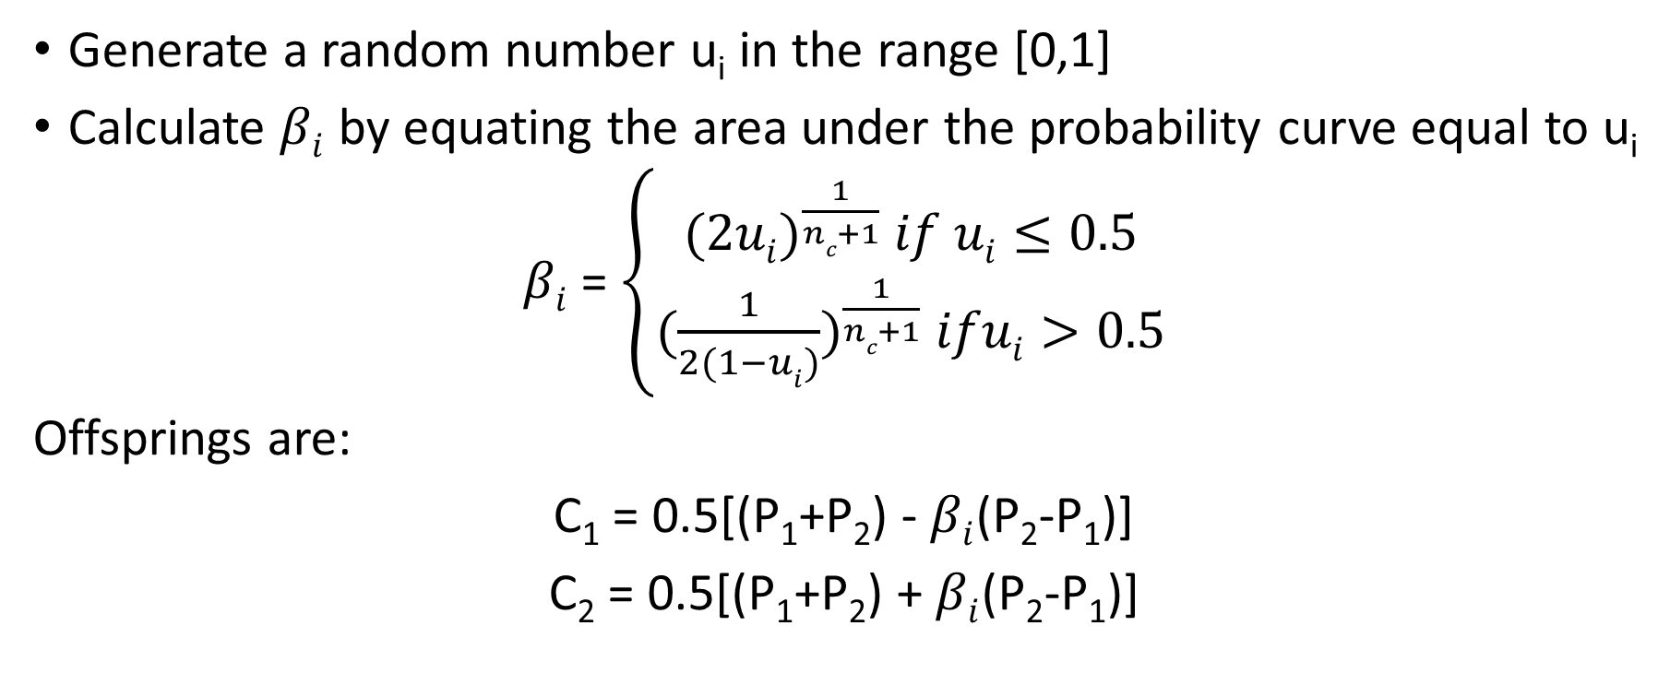
Simulated Binary Crossover in Real-Coded GAs
Generate a random number u_{i} in the range [0,1]
Calculate $βi$ by equating the area under the probability curve equal to u_{i}
$βi$ = $\left\{\begin{aligned}{(2ui)}^{\frac{1}{nc+1}} if ui≤0.5 \\ {(\frac{1}{2(1−ui)})}^{\frac{1}{nc+1}} ifui>0.5\end{aligned}\right.$
Offsprings are:
C₁ = 0.5[(P₁+P₂) - $βi$(P₂-P₁)]
C₂ = 0.5[(P₁+P₂) + $βi$(P₂-P₁)]

Slide 16
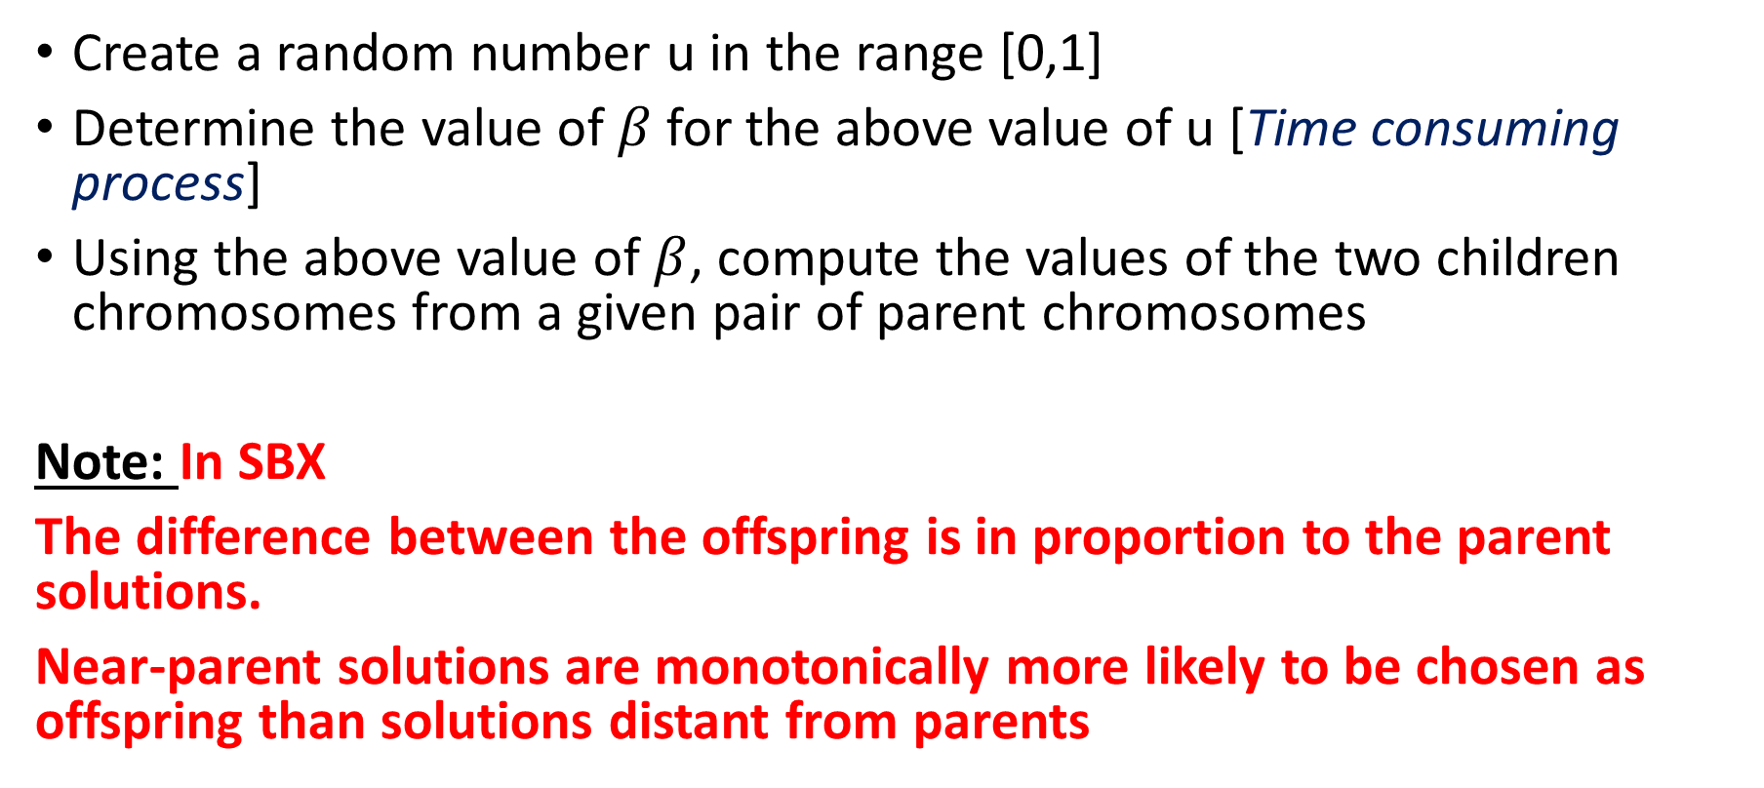
Steps for Simulated Binary Crossover
Create a random number u in the range [0,1]
Determine the value of $β$for the above value of u [Time consuming process]
Using the above value of $β$, compute the values of the two children chromosomes from a given pair of parent chromosomes
Note: In SBX
The difference between the offspring is in proportion to the parent solutions.
Near-parent solutions are monotonically more likely to be chosen as offspring than solutions distant from parents

Slide 17
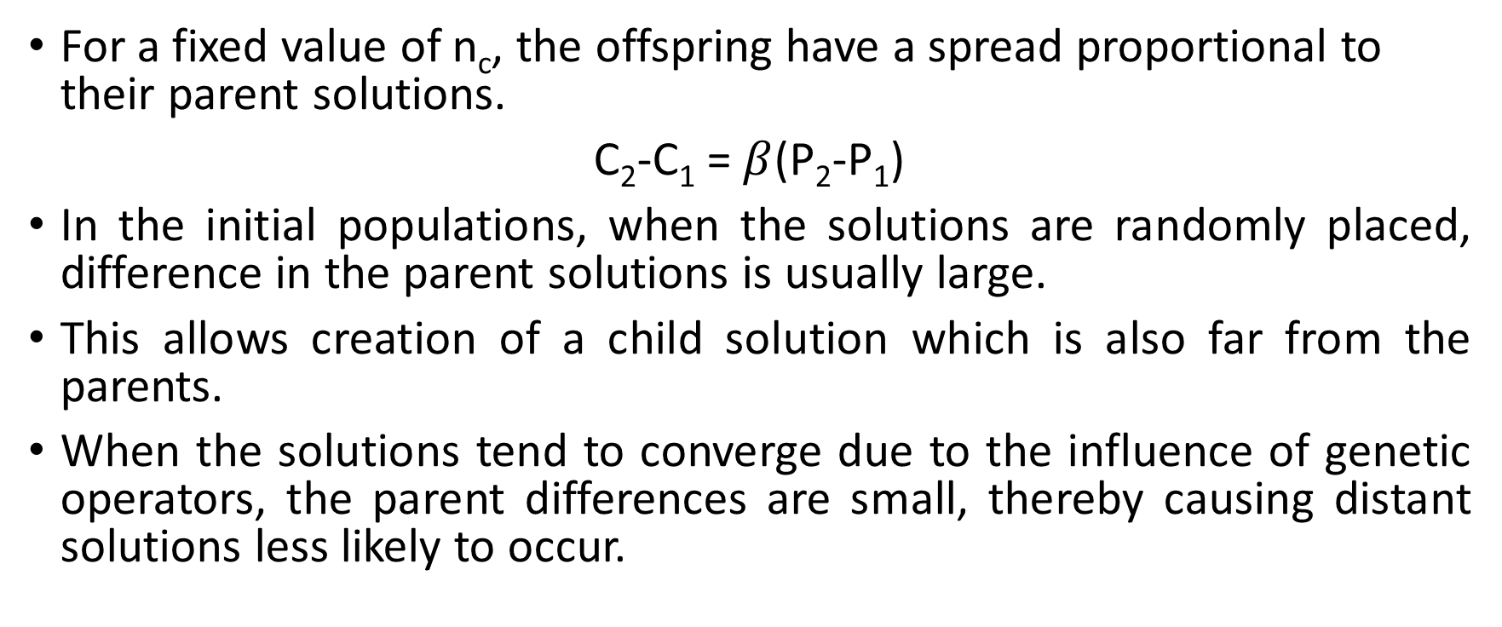
Simulated Binary Crossover in Real-Coded GAs
For a fixed value of n_{c}, the offspring have a spread proportional to their parent solutions.
C₂-C₁ = $β$(P₂-P₁)
In the initial populations, when the solutions are randomly placed, difference in the parent solutions is usually large.
This allows creation of a child solution which is also far from the parents.
When the solutions tend to converge due to the influence of genetic operators, the parent differences are small, thereby causing distant solutions less likely to occur.

Slide 18
Simulated Binary Crossover in Real-Coded GAs
Advantages
Possibility to generate a large number of offspring from two parents
More exploration capability with diverse offspring
Results are accurate and terminate at global optima
Usually, terminate in a less number of iterations

Slide 19
Simulated Binary Crossover in Real-Coded GAs
Limitations
Computationally expensive compared to binary crossover
Proper parameter values and density function must be chosen. Otherwise, it may lead to premature convergence with not necessarily optimum solutions

Slide 20
THANK YOU

